Slide 1
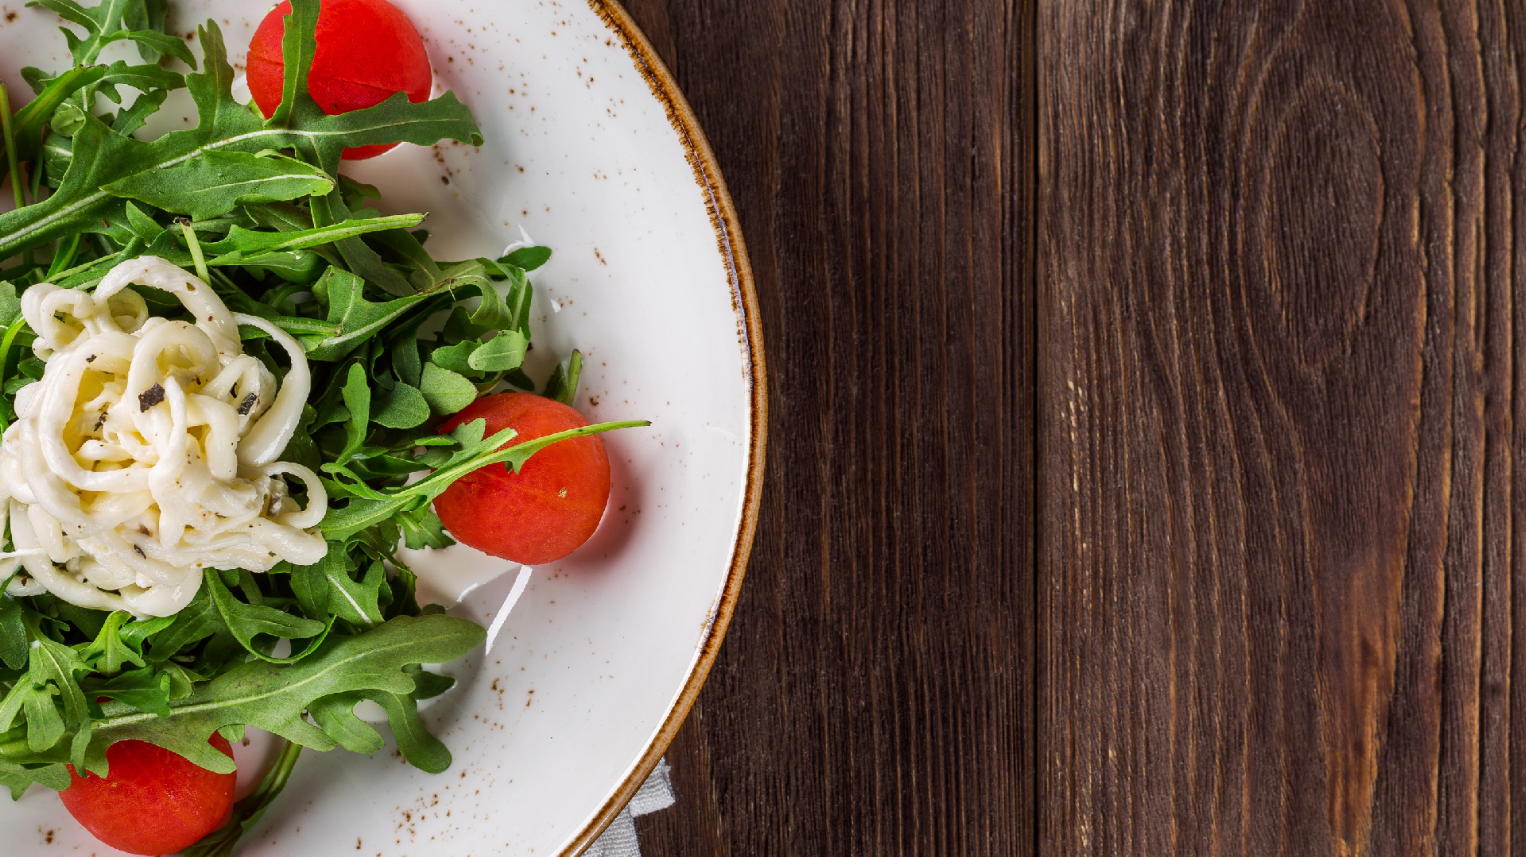

F I T B I T
The Ultimate eating planner
Group 11: Shivani Bajaj, Shahbaz Aslam, Ritvik Wadhwa

Slide 2




Data: NYC restaurant Food data Food recommendation system
Personalized suggestions for healthy food options User's daily calorie limit
Food category Preference

Slide 3



Consumers of this Information Product
-> Anyone looking to improve their health and wellness by adopting a healthier diet.
-> Relevant for Fitbit's existing user base
-> Conscious individuals who are already interested in tracking their fitness and wellness goals.
-> Food delivery companies so that they can mention this information on their app.

Slide 4
Features of this Information Product
Comprehensive food recommendation system
Provides personalized suggestions for healthy food options Leverages the dataset provided by the City of New York on nutritional information of food items sold in restaurants
Visually appealing user interface accessible via mobile app and web portal
Continuously updated with the latest nutritional information
.

Slide 5
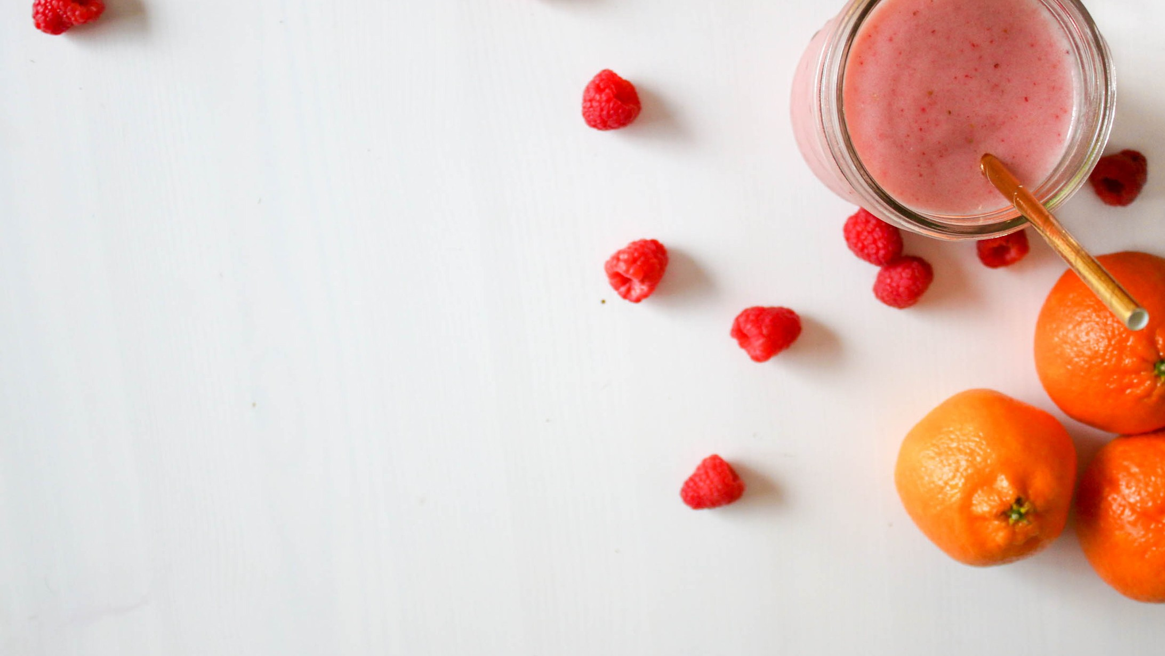
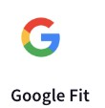

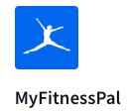
Porters' Forces Addressed by Fitbit's Food Recommendation System
Major Competitors:
Competitive Rivalry: a unique and one of its kind in personalized feature that helps users make informed decisions about their nutrition. First Mover advantage
Threat of Substitutes: a unique value added service for Fitbit users, making it less likely for users to switch to substitute products or services.

Slide 6
How does it work?
User inputs the calorie intake target at the start of day (Calorie Bank)
Feeds information on items consumed (Calories spent from Calorie Bank)
Does work out ( Calories lost during workout gets added to the calorie bank)- more calories available to spent now.
At any stage, dynamic recommendation for food items based on balance value of calorie bank for rest of Day.
am 1000 Cal(in surplus)
am
B/F- 200 cal
Bal. Cal- 800 cal
Gym- -300 cal Bal. Cal- 1100 cal Lunch- 400 cal Bal. Cal-700 cal
11 am
1 pm
Food Recommendation:

Slide 7
Data Source
New York Government website https://data.cityofnewyork.us/api/views/qgc5-
Data 1 Source
ecnb/rows.csv?accessType=DOWNLOAD
The data set was chosen because
-it contains comprehensive information about menu items from various restaurants,
-including detailed nutritional content such as calories, fat content, carbohydrates, etc.
Data 2 Source
Fitbit Fitness Tracker Data (Kaggle) https://www.kaggle.com/datasets/nurudeenabdulsalaam/fi
tbit-fitness-tracker-data?select=dailyCalories_merged.csv
The data set was chosen because
-it contains data on activities, dates, and calorie burn read by the Fitbit fitness trackers.

Slide 8

Data Wrangling
Data Source 1
Initial dataset had 65219 rows and 49 columns
Columns that did not provide relevant information (serving_size unit etc.) were dropped
Rows with NaN values in the calorie column were dropped
Missing values in 19 columns were filled with value zero for analysis
Cleaned dataset had 55315 rows and 32 columns
Data Source 2
Dataset 2 taken from fitbit is clean.

Slide 9

Implementation
Possible methods Recommender System
Collaborative Filtering Content-based Filtering Hybrid Models
Deep Learning Models
to develop our

Slide 10
Implementation
Collaborative Filtering
For this project, Collaborative Filtering seems like the most suitable choice, as it takes into account the user's past preferences to make recommendations
It can also help us recommend items that a user might not have considered in past but is being consumed by users with similar traits

Slide 11
Implementation Steps
User-Item Matrix Similarity Calculation
Recommendation Generation

Slide 12
Dashboard -
First graph: Total number of restaurants in the dataset. Second graph: Category count
Third graph: Kids meal availability and count Fourth graph: Calorie content and per 100g
Other graphs: Sodium, Carbohydrates, Saturated Fat, Dietary Fiber, Protein, and Cholesterol, all presented per 100g of food
Filter: Easily switch between restaurants
Powerful tool for restaurants and food delivery apps Provide more comprehensive information to customers

Slide 13
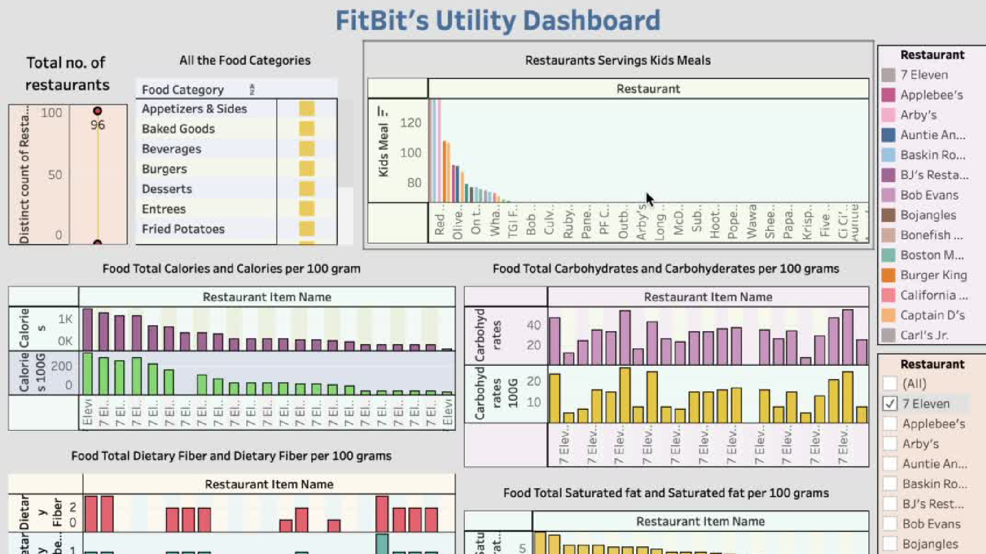

Slide 14
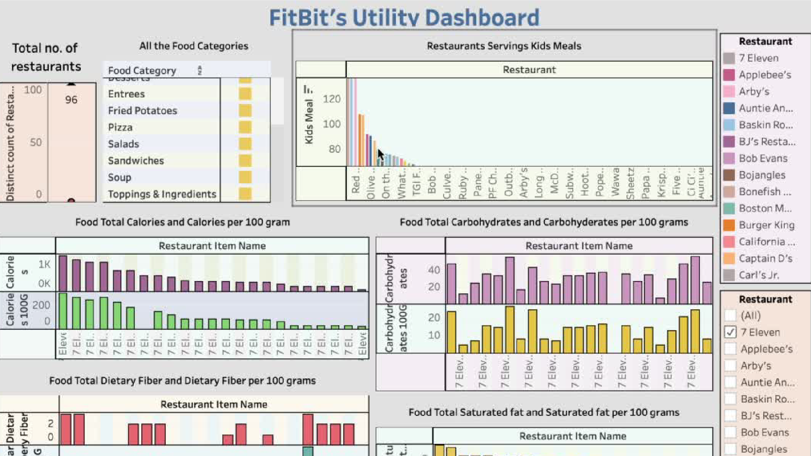

Slide 15
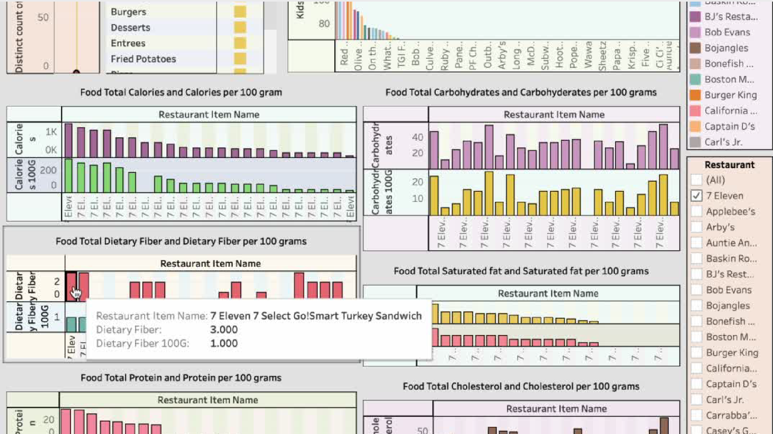

Slide 16
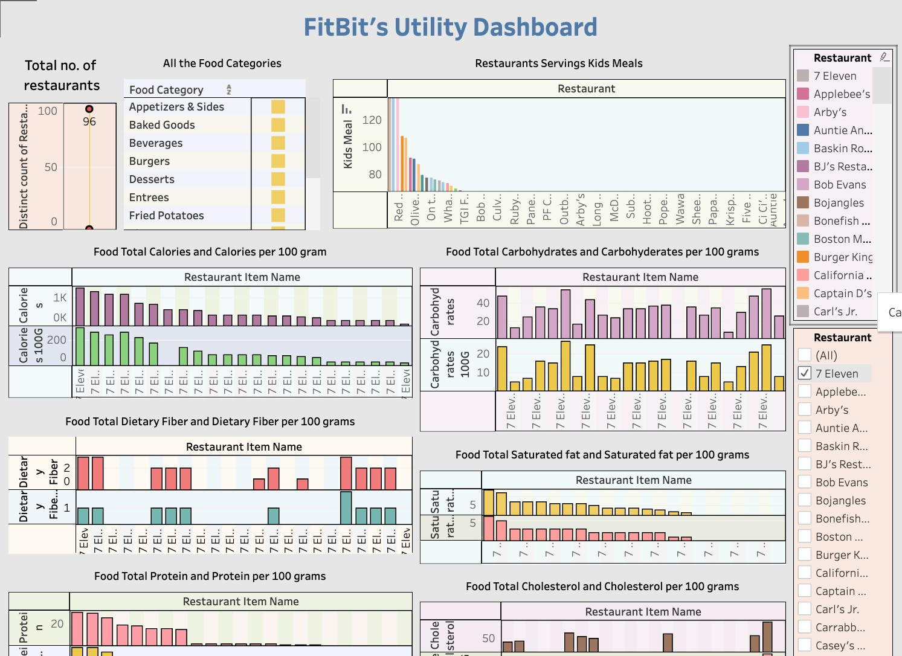

Slide 17

Challenges
User privacy and data security
Managing the vast amounts of data
Ensuring that the system operates efficiently and effectively

Slide 18
Future Development
Incorporating additional data sources such as demographics, location, etc to further enhance the system's personalization
Utilizing deep learning models such as neural networks to provide even more accurate and nuanced recommendations

Slide 19


Conclusion
Potential to revolutionize the way we discover and choose food items from menus
Provide personalized recommendations that increase user satisfaction and loyalty

Slide 20

THANK YOU
“The foods you choose make difference”
– You are what you eat

